Slide 1
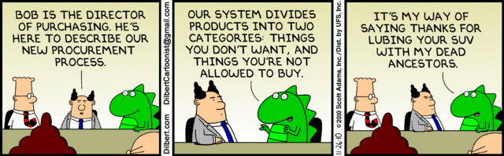
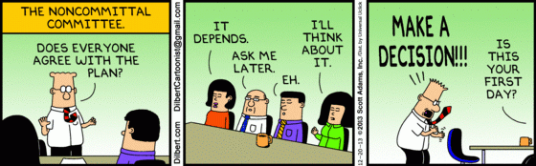
Cost Analysis and Estimation My Experience At Boeing
By: Misha Ward

Slide 2


Roadmap
Progress bar!
Background
Procurement Process
Cost Analysis and Estimation Tools
Process Improvements
Conclusion

Slide 3



Personal Background
Business degree from UW Bothell
Worked at Amazon.com for roughly 4 years
Two finance internships
Treasury experience
Worked at Boeing for 1.5 years
Procurement Financial Analysis for software
Notes:
There are four things that are needed for a team to work well and make good decisions...

Slide 4
Boeing Background - Continued
Vendors included: Microsoft (Word, PowerPoint, Excel, etc.) Tableau, SAP and many more
Procurement types: Software as a Service, Subscription, Purchase
Procurement amounts: Anywhere from $100,000 to $500,000,000
Primary objective: Achieve cost savings and ensure high quality

Slide 5

Boeing Background - Continued
Department Challenges:
Standardization
Analysis consistency
Managing stakeholders expectations
Lack of data
Preventing errors in analysis
Complexity of software

Slide 6
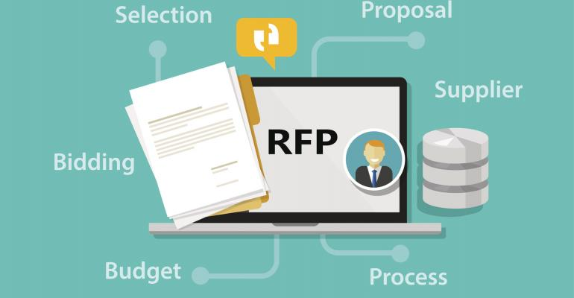
Procurement Process
Request for Proposal (RFP)
Business groups or PMs would request software to procure
Procurement Agent (PA) would gather specifications from team
Finance would help draft RFP templates for vendors to fill out
Procurement agent would send out cost templates and requirements to supplier

Slide 7

Procurement Process - Continued
Proposal Analysis
Business groups, Finance, and sometimes Legal would review the RFPs
Groups would rate the RPF based on Quality, Cost, and Terms and Conditions
Negotiations and Counter Negotiations
The procurement team would choose vendors to negotiate to lower cost
Procurement Approval
The process ended with the procurement being approved by all stakeholders (usually department VPs)

Slide 8
Cost Analysis and Estimation Tools
Labor Rate Database
Kept track of historical, consultant, Government, and paid online databases labor rates
Templates
Automated templates that took in data from suppliers and provided cost breakdowns
Statistical Tools
Software, Excel templates including complex regression analysis
Net Present Value (NPV) Calculations
Notes:
Groupthink: too many individuals thinking alike (think of CEO and executive team) or Enron

Slide 9

Process/Tools Improvements
Templates
Improved quality
Consistency
Standardization
Tracking Metrics
Errors
Labor Rates
Prior procurements
New Databases
Improved data

Slide 10

Conclusion
Project Manager Takeaways:
The procurement process is important for managing costs
Use available tools to help you stay on budget
Leverage your team to help reduce costs and solve problems

Slide 11

Questions?

